Slide 1

CS302 Design and Analysis of Algorithms
Muhammad sohail afzal

Slide 2
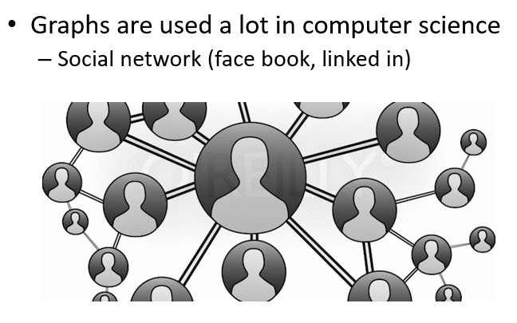
Graphs

Slide 3
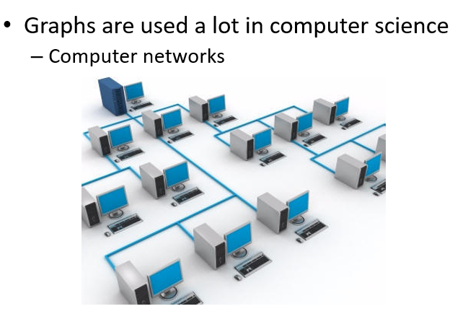
Graphs

Slide 4
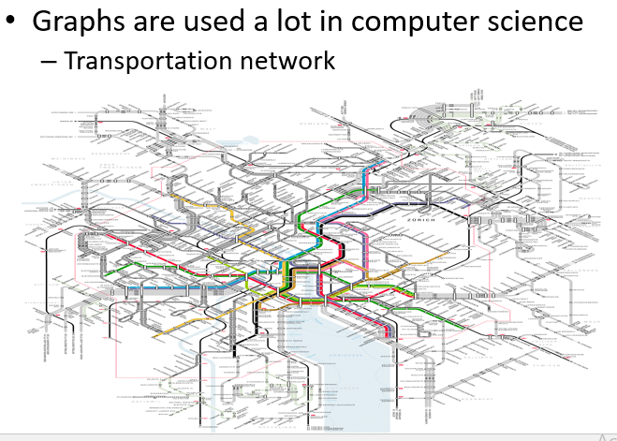
Graphs

Slide 5
Graphs
It has two main types :
Directed graphs (also known as digraphs)
These graphs have edges with direction. The edges indicate one way relationship in that each edge can only be traversed in one direction
Undirected graphs
These graphs have edges that do not have direction. Edges indicate a two way relationship in that each edge can be traversed in both directions.

Slide 6
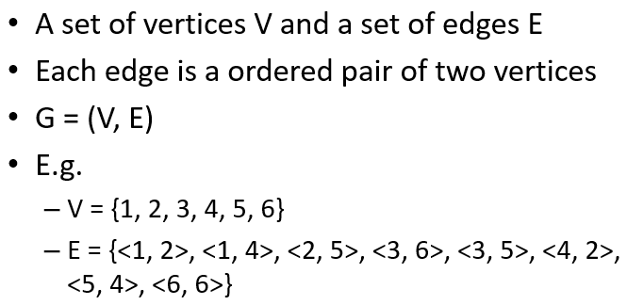
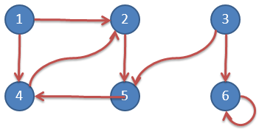
Graphs: Directed graph

Slide 7
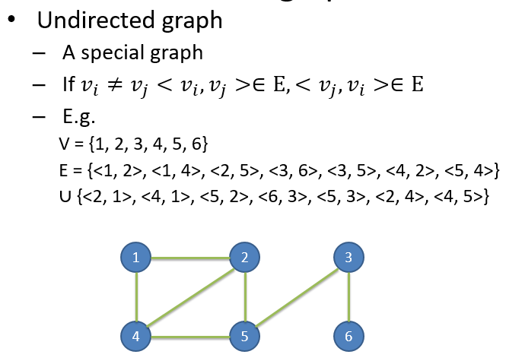
Graphs : Undirected graph

Slide 8
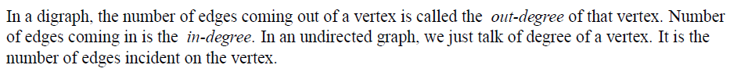
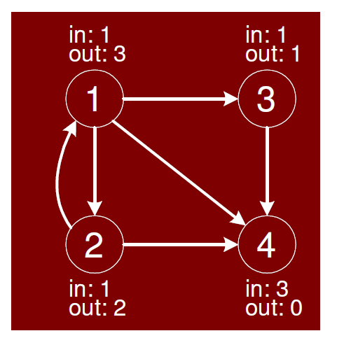
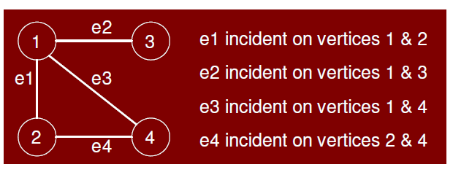
Graphs: in degree & out degree

Slide 9
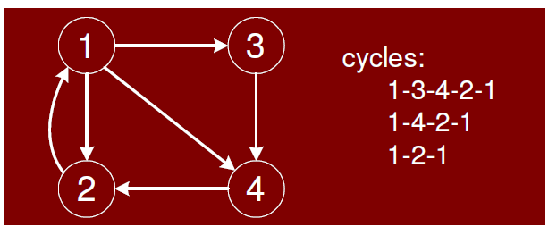
Graphs : Cycles in digraph

Slide 10
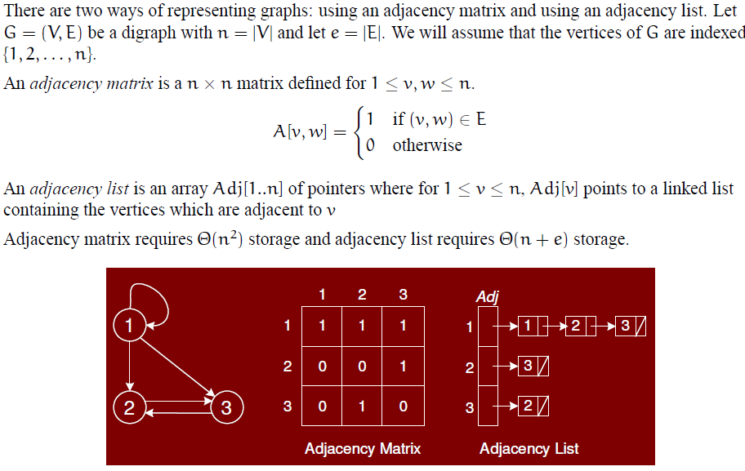
Graphs: How to represent graph

Slide 11
Graphs – Minimum spanning tree (MST)
A minimum spanning tree (MST) or minimum weight spanning tree is a subset of the edges of a connected, edge-weighted undirected graph that connects all the vertices together, without any cycles and with the minimum possible total edge weight/costs.

Slide 12
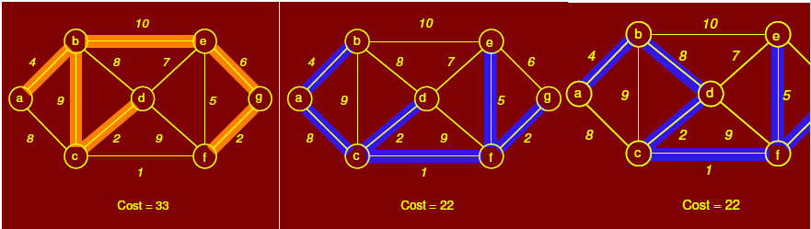
Graphs – Minimum spanning tree (MST)
Below figure shows three spanning trees for same graph. First is a spanning tree but not MST while other two are MST.

Slide 13
Graphs – Minimum spanning tree (MST)
There are two greedy algorithms (greedy in a sense that both chooses the best edge i-e having minimum cost) for finding minimum spanning tree
1) kruskal algorithm (time complexity = theta(ElogV) )
2) Prims Algorithm (time complexity = theta(ElogV) )
Where E is set of edges and V is set of vertices
Applications of Minimum Spanning Tree :
Laying cables
Laying pipes network or phone network
Tour Operations and many more

Slide 14
Graphs – Kruskal Algorithm for MST
Kruskal algorithm Steps for finding MST :
First select minimum cost edge.
Now select next minimum edge such that it does not form a cycle after addition and repeat this process.
At the end, you will get minimum spanning tree. Sum the cost of all edges and that will be the minimum spanning tree cost.

Slide 15
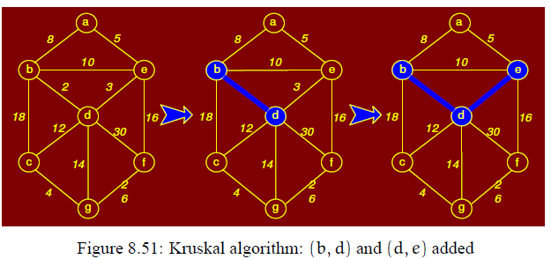
Graphs – Kruskal example

Slide 16
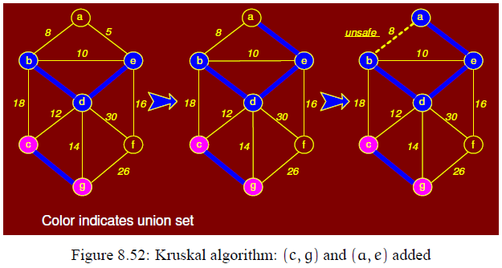
Graphs – Kruskal example

Slide 17
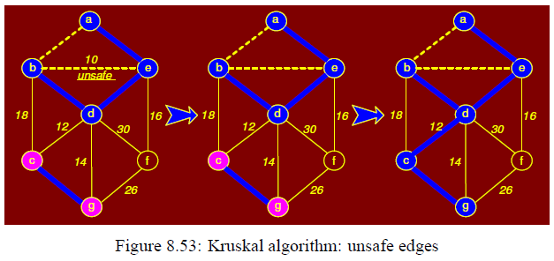
Graphs – Kruskal example

Slide 18
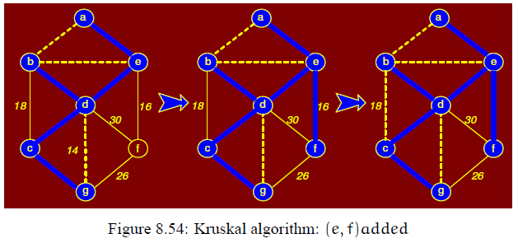
Graphs – Kruskal example

Slide 19
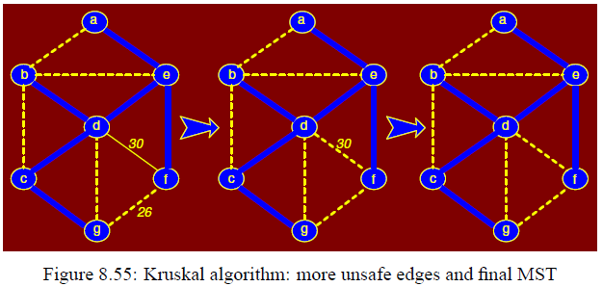
Graphs – Kruskal example
Graph at the end (most right side) is minimum spanning tree.

Slide 20
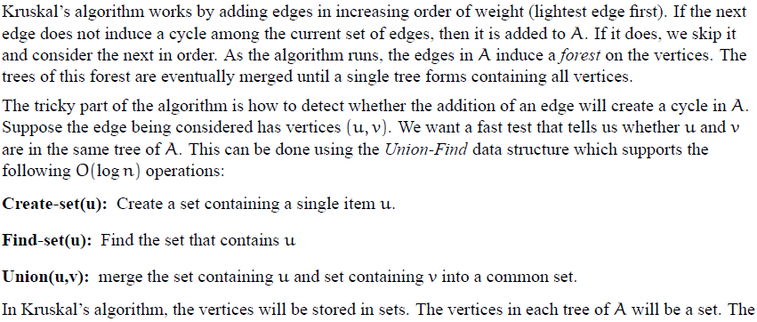
Graphs – Internal Working of Kruskal

Slide 21
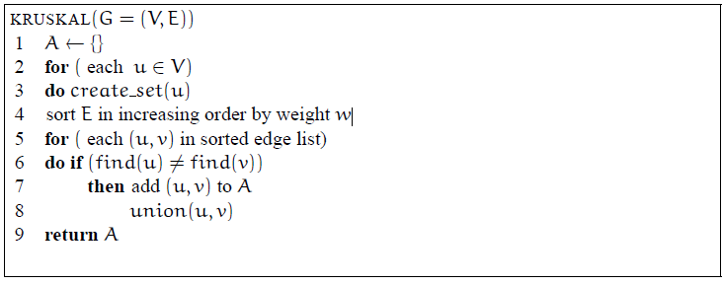
Graphs – Internal Working of Kruskal
Or you can write theta(ElogE) to theta(ElogV) as number of nodes and vertices are almost equal

Slide 22
Graphs – Prims algorithm for MST
Prims algorithm Steps for finding MST :
Randomly select first vertex
Now check all the edges adjacent/connected to first selected vertex and update weights of connected vertices.
Select that edge which has minimum cost among all connected edges.
Now this selected edge has two vertices. Check all the edges connected to these two vertices and select minimum.
Then it will have three vertices. Select minimum edge among edges connected to these three vertices and so on
At the end, you will get minimum spanning tree. Sum the cost of all edges that will be the minimum spanning tree cost.

Slide 23
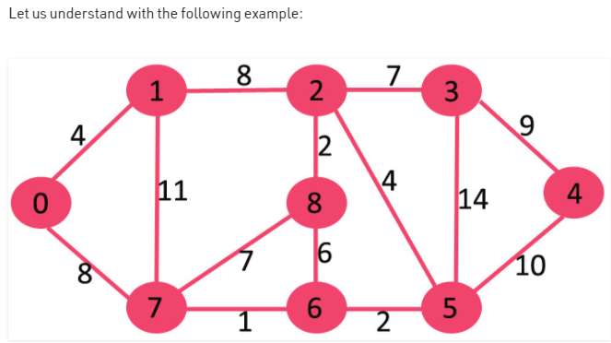
Graphs – Prims Example

Slide 24
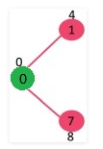
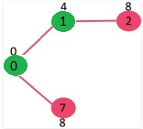
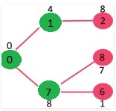
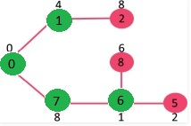
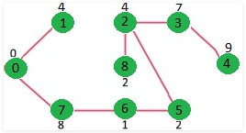
Graphs – Prims Example
This process goes on and at the end you get below minimum spanning tree :

Slide 25
Graphs : Prims algorithm Example 2
Now another Example of prims algorithm in next slide that will show you how prims work actually using minimum priority queue

Slide 26
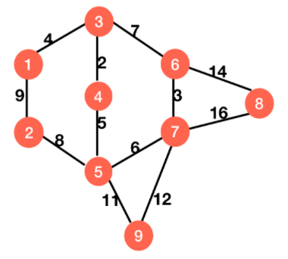
Graphs – Prims Example 2 (Internal working in detail )
We will see complete working of prims in detail (with minimum priority queue) through another example given below

Slide 27
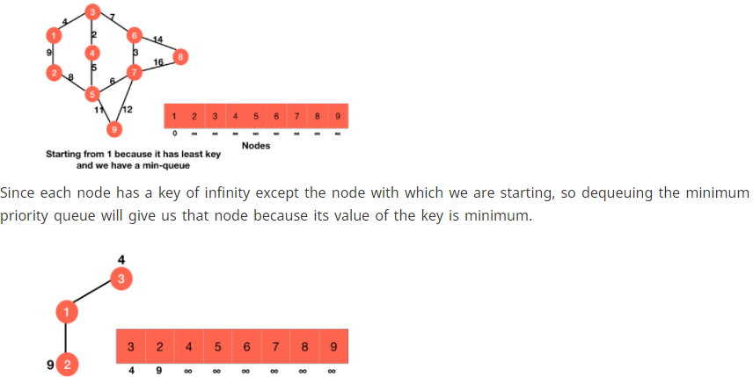
Graphs – Prims Example 2 (Internal working in detail)

Slide 28
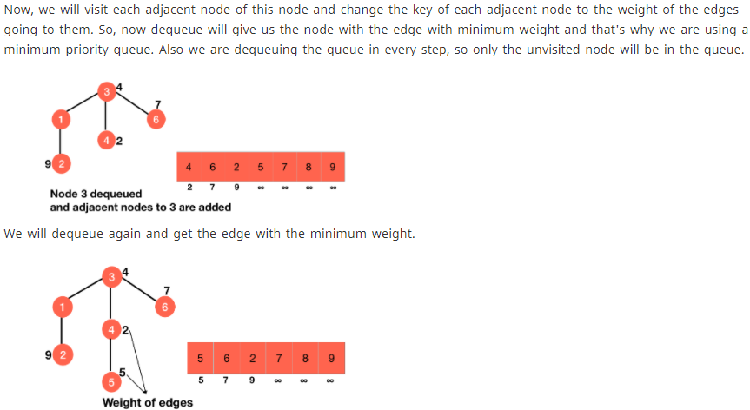
Graphs – Prims Example 2 (Internal working in detail)

Slide 29
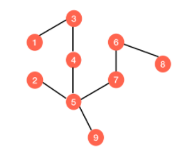
Graphs – Prims Example 2 (Internal working in detail)
And this goes on and on till you get this minimum spanning tree after traversing through all the vertices of priority queue :

Slide 30
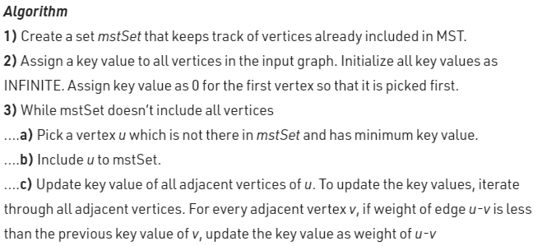
Graphs – Prims algorithm pseudo code
Correction* : In above prims algorithm, u-v in second last line stands for “u to v edge” and not “u minus v”

Slide 31
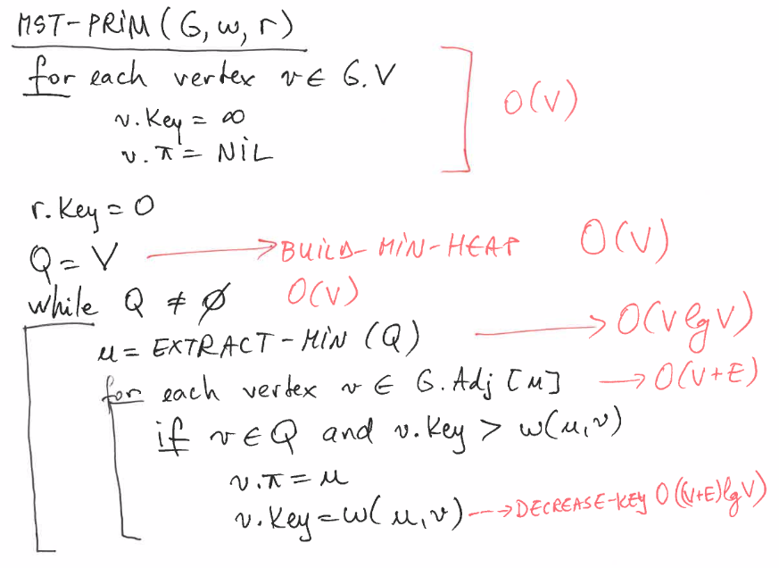
Graphs – Prims algorithm pseudo code
The time complexity is O(VlogV + ElogV) = O(ElogV), making it the same as Kruskal's algorithm.

Slide 32
Kruskal & Prims – Greedy algorithms
Kruskal algorithm is greedy algorithm because we choose to union two set of vertices each step according to the minimal weight available, we choose edge that looks optimal at the moment. This is greedy step and thus the algorithm is said to be greedy
Prim's Algorithm is also greedy in the sense that it reorders its input in order to choose the cheapest connected edge every time

